Slide 1


Visvesvaraya Technological University
Jnana sagama , Belagavi-590018
INTERNSHIP MINI PROJECT PRESENTATION
“ATM Simulator using Python”
By,
Jashwanth V Gowda [4MU16EC017]
Under the Guidance of -
MOHAMMED ALI
Assistant Professor Dept.of E&C, MRIT
MYSURU ROYAL INSTITUTE OF TECHNOLOGY
Department of Electronics and communication Engineering
SR Patna,mandya-571606

Slide 2
CONTENTS
Introduction
Mission and mission of company
Introduction for python
Hardware and software specification
Mini project-ATM Simulation using Python
Flow Chart
Program for ATM Simulation
Result

Slide 3
Introduction
The “Q-spiders” providing an option for students to take part in Internship & In-Plant Training(IPT) by considering the demand for trained students under various software technologies.
This program helps a student in gaining practical knowledge of both Hardware and software subjects.
By being part of this program students can get exposure on real-time projects with complete support from experienced trainers for both theoretical and practical areas.
After training is completed they will provide a certificate of completion.
Q-spiders Company started in the year 2014 in Bangalore with the view to make the business folks to adopt the recent technological services into their respective industries.
Q-spiders is an IT and Training service providers headquartered at Bangalore.
They build solid and respected business by specializing in Developing Application, Providing IT Consulting Services, and Maintenance and Support.

Slide 4
Mission and vision of company
Professional certification courses. They associate with industry experts to deliver the training requirements of Job seekers and working professionals.
To become a globally admired organization. Engage job seekers, working professionals, employers and universities around the globe for fulfilling their needs through education.
Their mission is to provide best in class education via robust technology platform and to achieve almost customer satisfaction.
At Q-Spiders, they have ensured that the training is imparted by specialists with proven subject matter expertise and who have spent over a decade in their area of specialization.
The faculties of their team are highly competent, skilled and dedicated to giving their best towards the professional development of the students. Besides training, they also provide placement assistance.

Slide 5

Python is an interpreted, high-level, general-purpose programming language. Created by Guido van Rossum and first released in 1991, Python's design philosophy emphasizes code readability with its notable use of significant whitespace. Its language constructs and object-oriented approach aim to help programmers write clear, logical code for small and large-scale projects.
Python is dynamically typed and garbage-collected. It supports multiple programming paradigms, including procedural, object-oriented, and functional programming. Python is often described as a "batteries included" language due to its comprehensive standard library.

Slide 6
Hardware And Software Specification
Minimum Hardware Requirements
Processor : Intel i3 2.4GHz.
Hard Disk : 40GB.
RAM : 4 GB or above.
Software Requirements
Operating system : Windows 7 and above.
Coding Language : Python.
IDLE : PyCharm. / Visual Studio 2015.

Slide 7
Mini Project-ATM Simulation using python
This application allows the customers to collect cash and transact money from one account to another just by giving his/her account number.
It allows authorized users to access the system by typing a valid account number.
This application allows to change password and inquiry account balance of customer who have valid bank account number.
It also enables you to transaction on the current account.

Slide 8
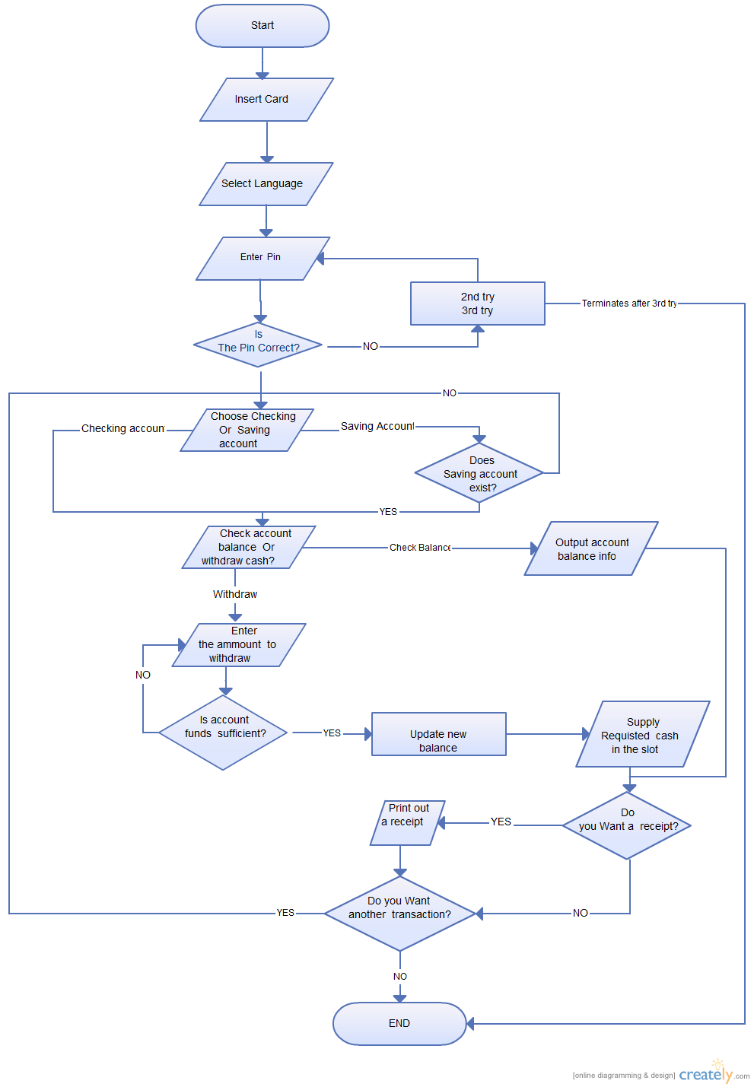
Flow Chart

Slide 9
Features
Log in.
Deposit Amount.
Withdraw Amount.
Balance Enquiry.
Change pin.

Slide 10
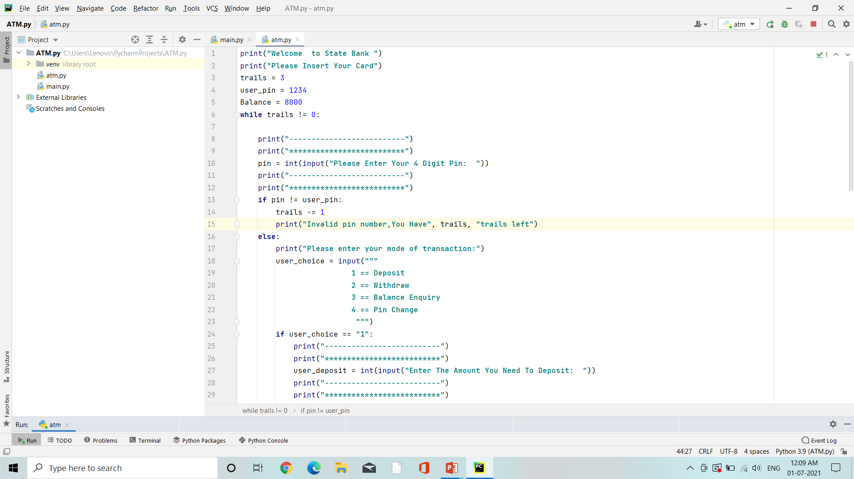
Program for ATM Simulation

Slide 11
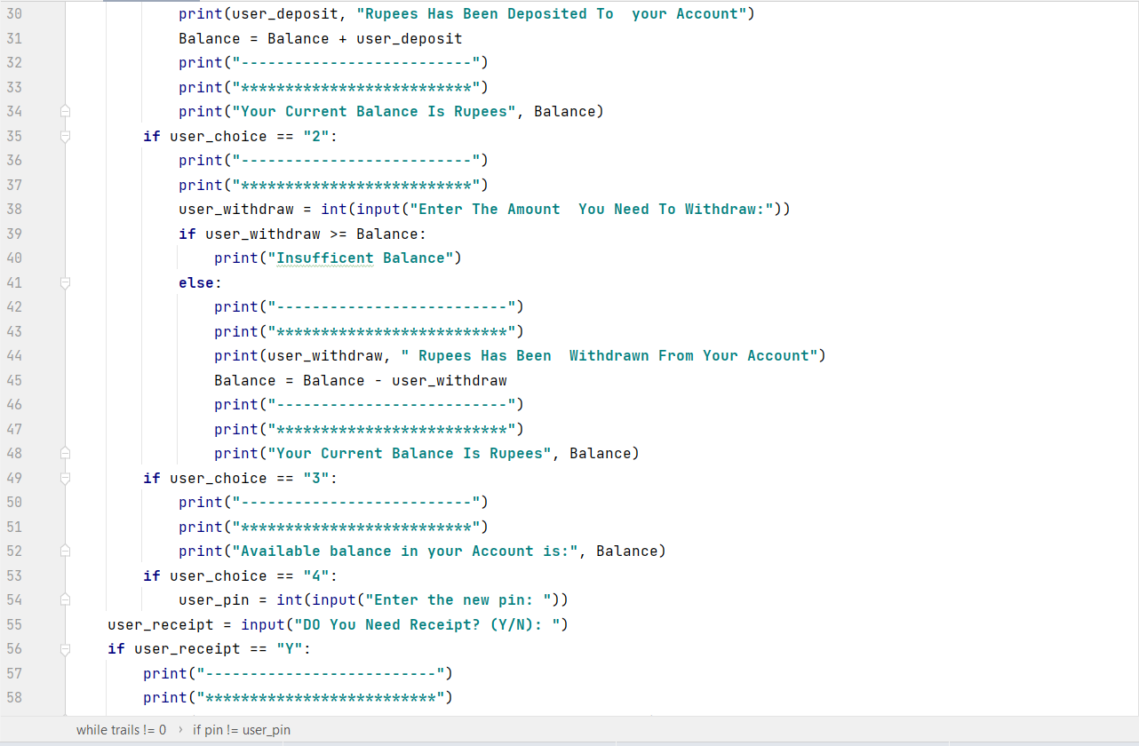

Slide 12
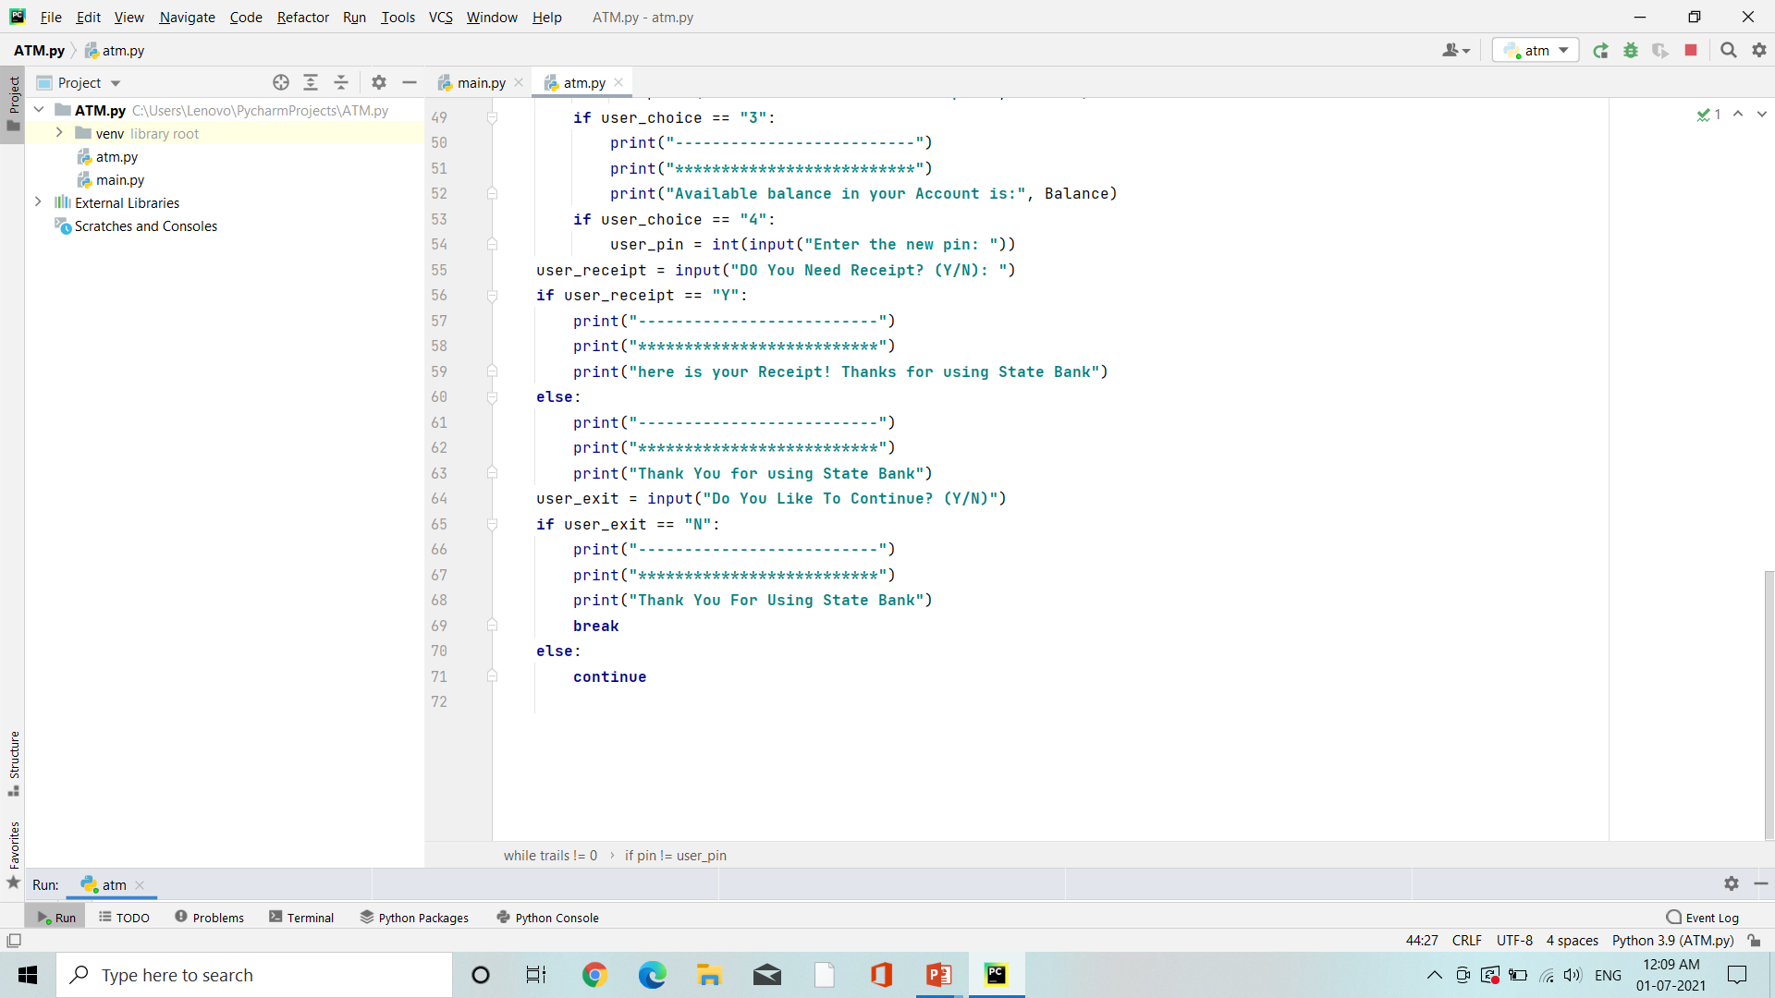

Slide 13
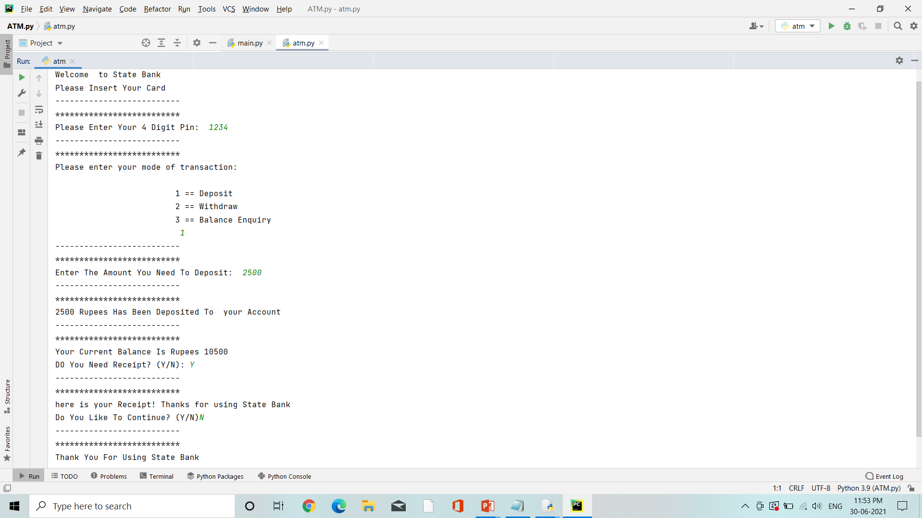
Results:
1.Deposit Amount

Slide 14
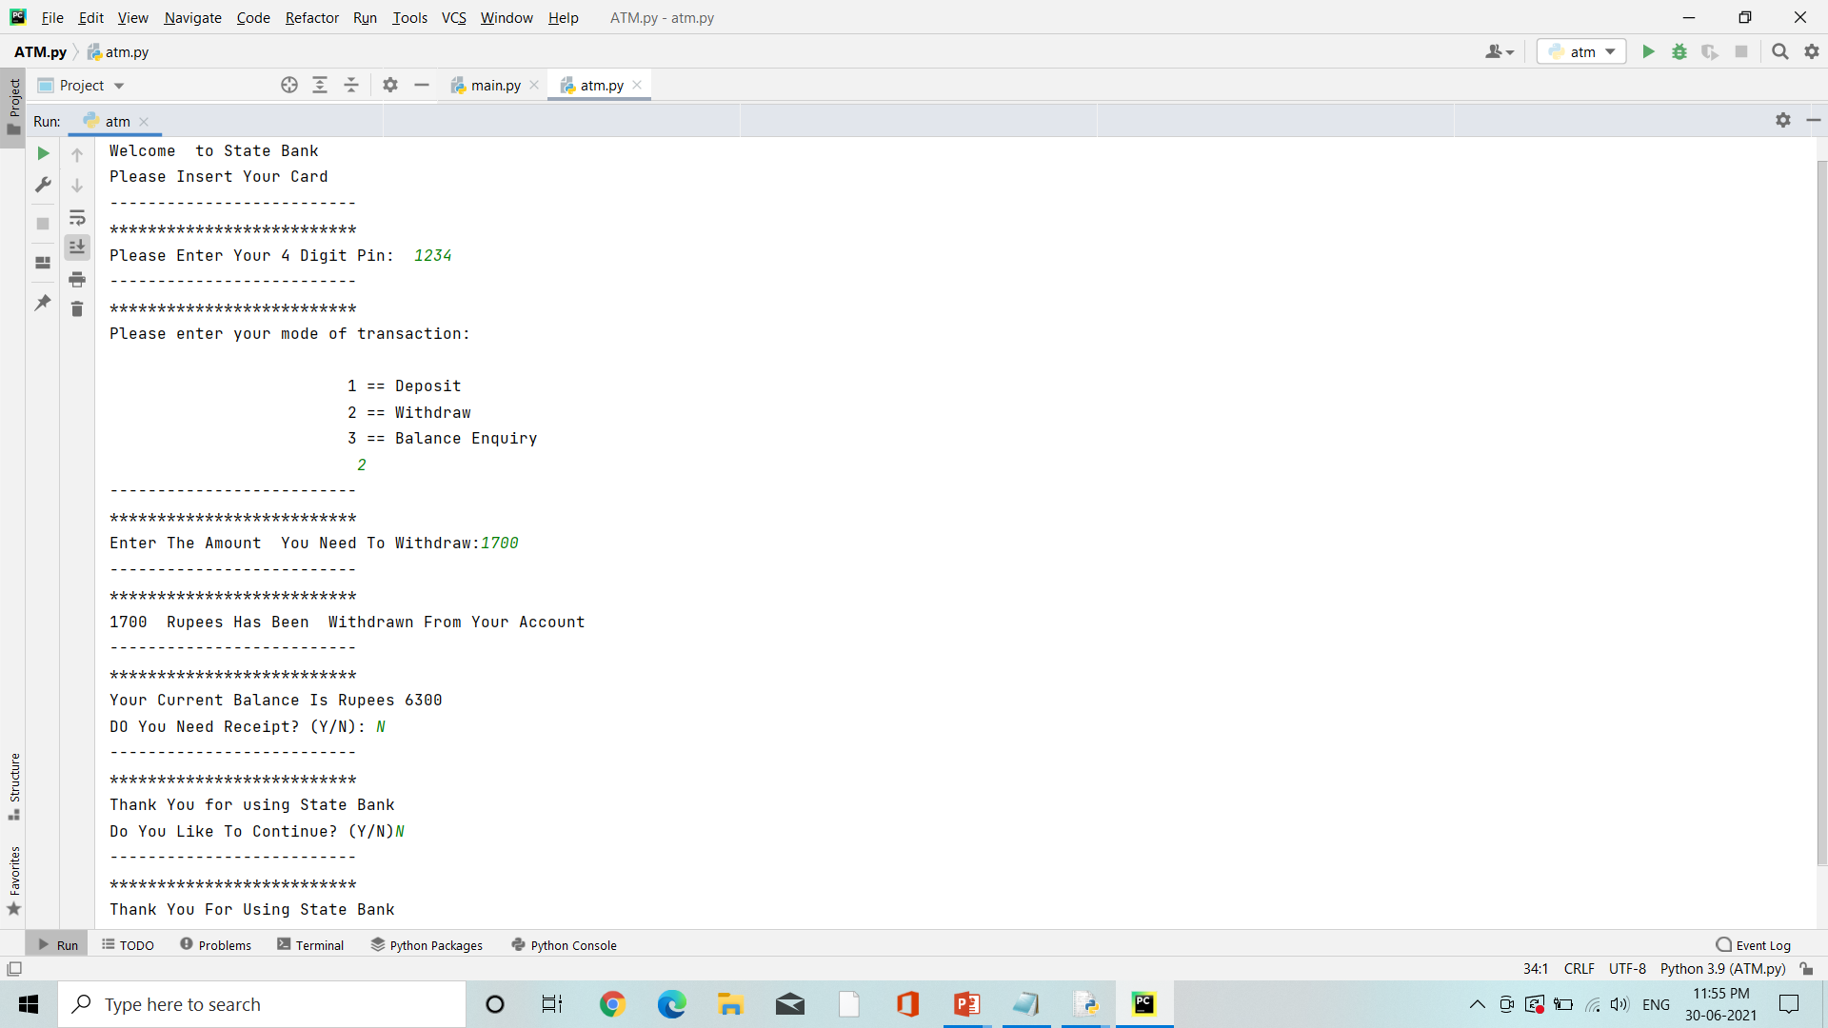
2.Withdraw Amount

Slide 15
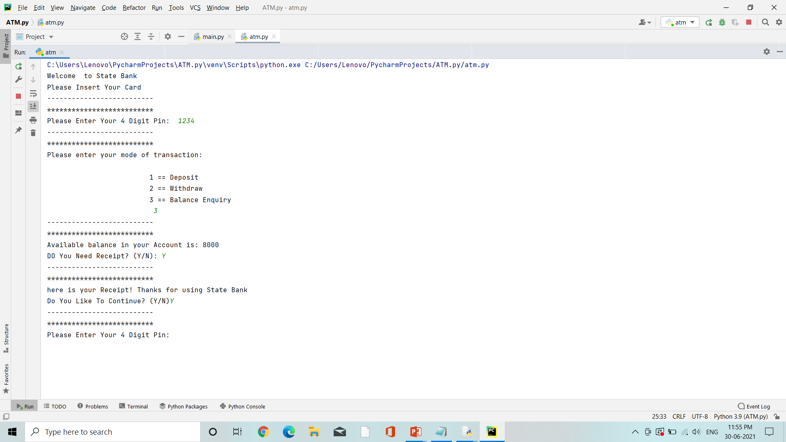
3.Balance Enquiry

Slide 16
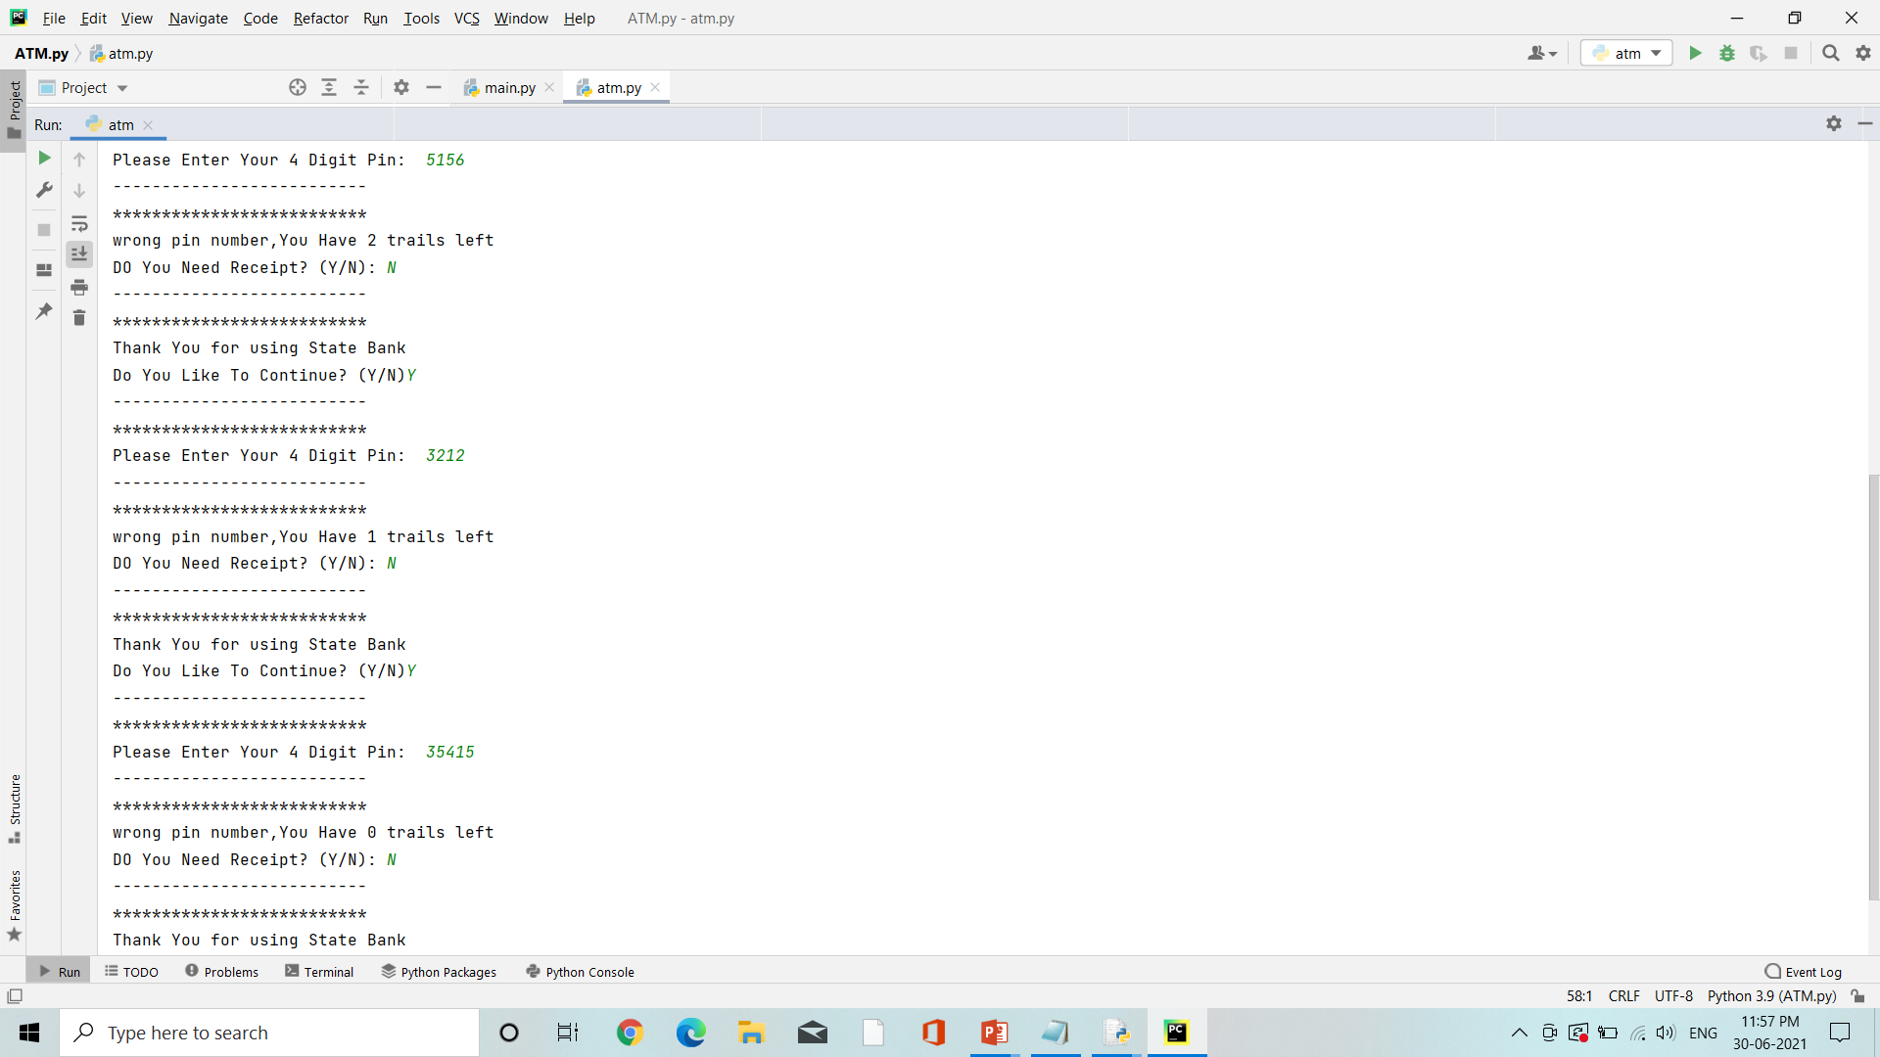
4.Incorrect PIN

Slide 17
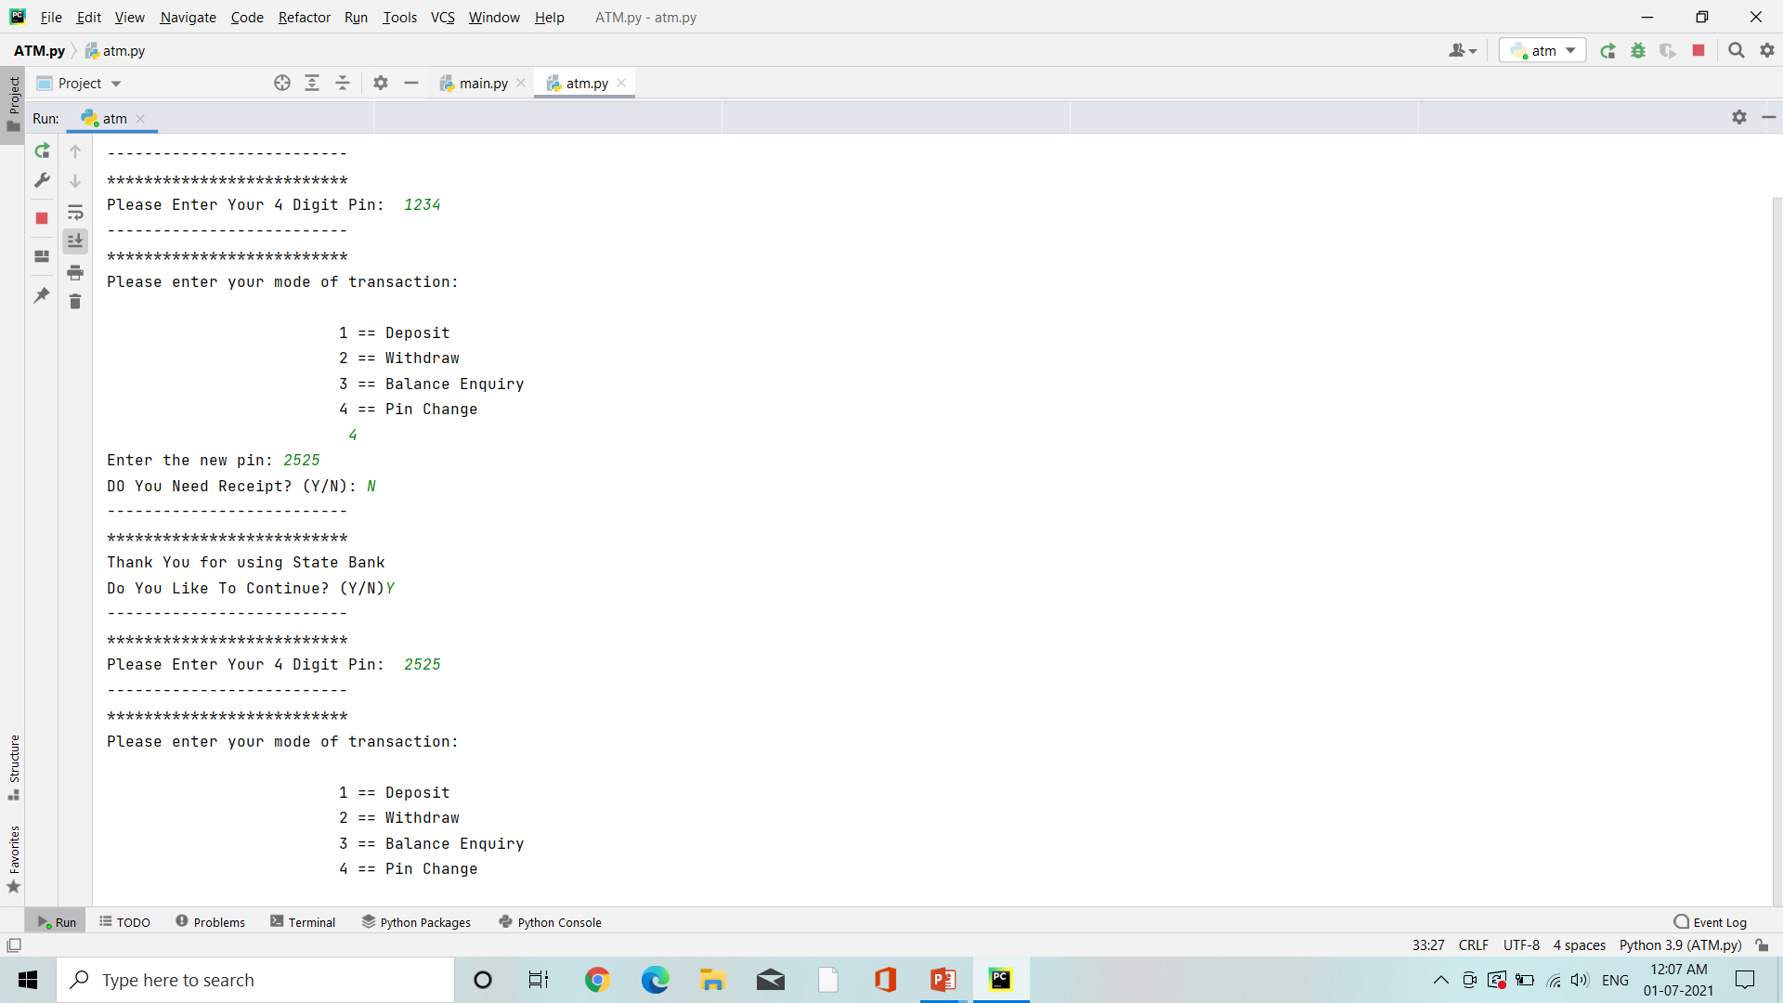
5.PIN Change

Slide 18
THANK YOU

